Slide 1

ONTOLOGY ENGINEERING
Group 14: Artificial Intelligence(Dr. Pushpak Bhattacharya)
Aliabbas Petiwala
Ajay Nandoriya
Pramendra Singh Rajput

Slide 2

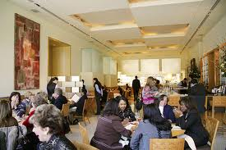
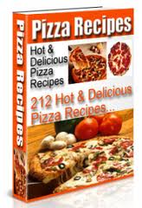
Deciding and constructing Pizza Terminology to avoid Inconsistency
Customer
Restaurant Menu
Which Vegetarian Pizza is Least Spicy?
A shared
ONTOLOGY
of
Pizza
Mexican Vegetarian Pizza
American Vegetarian Pizza Recipe

Slide 3
Outline
What is ontology Engineering?
Ontology Engineering versus
Object-Oriented Modeling
Why develop an ontology?
Developing an ontology
Going deeper: Common problems and solutions
Ontologies in the Semantic Web languages
Current research issues in ontology engineering

Slide 4
What Is “Ontology Engineering”?
Ontology Engineering:
Ontology engineering is a set of tasks related to the development of ontologies for a particular domain.
Defining terms in the domain and relations among them
  Defining concepts in the domain (classes)
  Arranging the concepts in a hierarchy (subclass-superclass hierarchy)
  Defining which attributes and properties (slots) classes can have and constraints on their values
  Defining individuals and filling in property values
  Ontology Engineering analogous to OO Database Design?

Slide 5
Ontology Engineering versus
Object-Oriented Modeling
An OO class structure
reflects the structure of the data and code
is usually about behavior (methods)
  Object-oriented classes are templates for constructing objects.
Attributes and associations have different meanings.
Closed World Assumption.
An ontology
reflects the structure of the world
is often about structure of concepts
  Formal ontological classes are sets which can be defined in terms of other classes, attributes and associations
  Property is a general term for attributes and associations.
  Open World Assumption
  means that lack of knowledge of a fact does not immediately imply knowledge of the negation of a fact.
Notes:
DL does not make the Unique Name Assumption (UNA) or the Closed World Assumption (CWA). Not having UNA means that two concepts with different names may be allowed by some inference to be shown to be equivalent. Not having CWA, or rather having the Open World Assumption (OWA) means that lack of knowledge of a fact does not immediately imply knowledge of the negation of a fact.

Slide 6
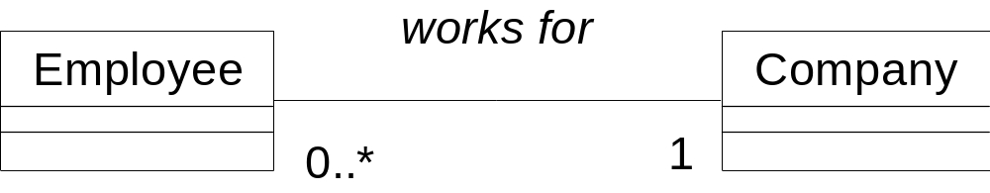
Logic: Open versus Closed
Open (monotonic) logic gives different answers to queries than a closed logic.
hasBase
Pizza
PizzaBase
Fact:Suppose that Americana is the only Pizza:
  Closed world: violates constraint
  Open world: Americana Pizza exists but its base is not known.

Slide 7
Logic: Open versus Closed
Open (monotonic) logic gives different answers to queries than a closed logic.
hasBase
Pizza
PizzaBase
Fact:ItalianPizza has bases CrispBase and HardBase:
  Closed world: violates constraint
  Open world: CrispBase and HardBase are same!.
Notes:
Adv loosely coupled we can add information which is apparently inconsistent but the system resolves the inconsistencies

Slide 8
Axioms for OWL Ontology
An OWL ontology is a set of axioms
  Class Axioms: C ⊑ D, C ≡ D
  Role Axioms: R ⊑ S, Func(R), Trans(S)
  Individual Axioms: a:C, <a,b>:R
Animal
CanSwim
Ontology example
  Fish⊑ Animal ⊓ CanSwim
  Jellyfish⊑ Fish⊓ ¬hasVertebra
  Pomfret⊑ Fish
  Moonjelly:Jellyfish
⊓
¬hasVertebra
Fish
⊓
Pomfret
Jellyfish
Moonjelly
Notes:
An OWL ontology is a set of axioms which include classes axioms C is a subclass of D, or C is equivalent to D, role axioms R is a subrole of S, R is a functional role, S is a transitive role, and individual axioms, a is an individual of C, a participates in a R role with b.
Here is an ontology example, fish is a sublcass of Animal and CanSwim, and fish is a subclass of animal and canswim…. Moonjelly is an individual of jellyfish.

Slide 9
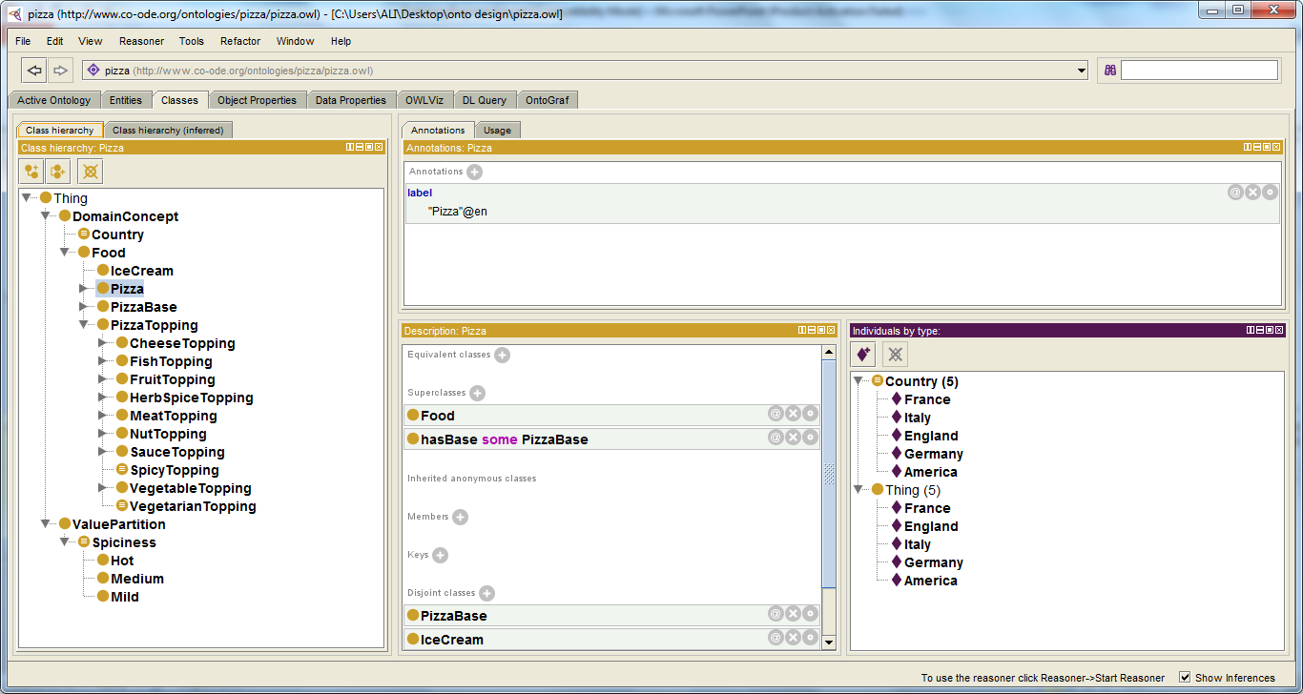
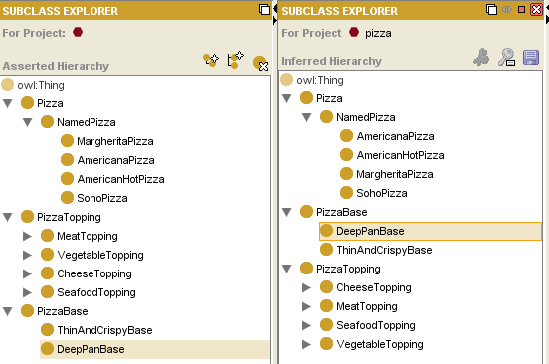
Food Domain: Pizza Ontology in Protege.

Slide 10
Ontology Engineering Process
An iterative process:
determine
scope
consider
reuse
enumerate
terms
consider
reuse
define
classes
enumerate
terms
define
classes
define
properties
define
classes
define
properties
define
constraints
create
instances
define
classes
create
instances
consider
reuse
define
properties
define
constraints
create
instances

Slide 11
Ontology Engineering Tools
Protégé, which:
  is a graphical ontology-development tool
  supports a rich knowledge model
  is open-source and freely available
  (http://protege.stanford.edu)
Some other available tools:
  Ontolingua and Chimaera
  OntoEdit
  OilEd
  DOGMA
  DogmaModeler
  KAON
  OntoClean
  OnToContent
  HOZO

Slide 12
Determine Domain and Scope
determine
scope
consider
reuse
enumerate
terms
define
classes
define
properties
define
constraints
create
instances
What is the domain that the ontology will cover?
For what we are going to use the ontology?
For what types of questions the information in the ontology should provide answers (competency questions)?
Answers to these questions may change during the lifecycle

Slide 13
Competency Questions For determining scope
Which Pizza characteristics should I consider when choosing a Pizza?
Is Veg or Non Veg?
Does Pizza go well with Ice Cream?
Which is the best choice among Veg pizza .
What kind of Pizza bases available?
Pizzas from which countries are available?
Which Pizza is the least spicy?

Slide 14
Consider Reuse
determine
scope
consider
reuse
enumerate
terms
define
classes
define
properties
define
constraints
create
instances
Why reuse other ontologies?
  to save the effort
  to interact with the tools that use other ontologies
  to use ontologies that have been validated through use in applications
General ontologies
  DMOZ (www.dmoz.org)
  WordNet (www.cogsci.princeton.edu/~wn/)
Domain-specific ontologies
  UMLS Semantic Net
  GO (Gene Ontology) (www.geneontology.org)

Slide 15
Enumerate Important Terms
determine
scope
consider
reuse
enumerate
terms
define
classes
define
properties
define
constraints
create
instances
What are the terms we need to talk about?
What are the properties of these terms?
What do we want to say about the terms?

Slide 16
Enumerating Terms - The Pizza Ontology
Pizza, Cheese , Toppings , Mexican , Sauce , Pizza Base,
Crispy…

Slide 17
Define Classes and the Class Hierarchy
determine
scope
consider
reuse
enumerate
terms
define
classes
define
properties
define
constraints
create
instances
A class is a concept in the domain
  a class of Pizza
  a class of PizzaBase
  a class of Country
A class is a collection of elements with similar properties
Instances of classes
  VegSpicyPizza.

Slide 18
Class Inheritance
Classes usually constitute a taxonomic hierarchy (a subclass-superclass hierarchy)
A class hierarchy is usually an IS-A hierarchy:
  an instance of a subclass is an instance of a superclass
If you think of a class as a set of elements, a subclass is a subset

Slide 19
Class Inheritance - Example
Pizza is a subclass of Food
VegetarianPizza is a subclass of Pizza
SpicyPizza is a subclass of VegetarianPizza.

Slide 20
Define Properties of Classes – Slots
determine
scope
consider
reuse
enumerate
terms
define
classes
define
properties
define
constraints
create
instances
Slots in a class definition describe attributes of instances of the class and relations to other instances
  Each pizza will have hasBase, hasTopping hasCountryOfOrigin.

Slide 21
Properties (Slots)
Types of properties
Simple and complex properties
  simple properties (attributes): contain primitive values (strings, numbers)
  complex properties: contain (or point to) other objects (e.g., a Pizza instance)

Slide 22
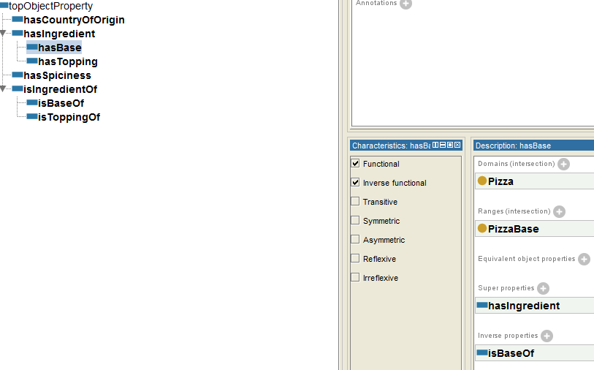
Properties for the Class Pizza
(in Protégé-2000)

Slide 23
property and Class Inheritance
A subclass inherits all the propertys from the superclass
  If a Pizza has a name and flavor, a AmericanPizza also has a name and flavor
If a class has multiple superclasses, it inherits properties from all of them.

Slide 24
Create Instances \Individuals
determine
scope
consider
reuse
enumerate
terms
define
classes
define
properties
define
constraints
create
instances
Create an instance of a class
  The class becomes a direct type of the instance
  If concepts form a natural hierarchy, then we should represent them as classes
  Individual instances are the most specific concepts represented in a knowledge base.
  if we would like to maintain an inventory of pizzas in the restaurant then use individuals.
  Assign property values for the instance
Notes:
\

Slide 25
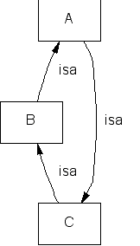
Avoiding Class Cycles
Danger of multiple inheritance: cycles in the class hierarchy
Classes A, B, and C have equivalent sets of instances
  By many definitions, A, B, and C are thus equivalent

Slide 26
The Perfect Family Size
If a class has only one child, there may be a modeling problem
Put It up:
AmericanPizza ----→ AmericanCreamPizza
  AmericanCreamPizza

Slide 27
Single and Plural Class Names
A “Pizza” is not a kind-of “Pizzas”
Class names should be either
  all singular
  all plural

Slide 28
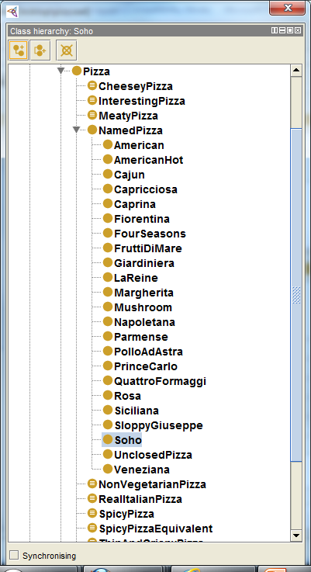
A Completed Hierarchy of Pizza

Slide 29
Outline
What is ontology Engineering?
Ontology Engineering versus
Object-Oriented Modeling
Why develop an ontology?
Step-By-Step: Developing an ontology
Ontologies in the Semantic Web languages
Current research issues in ontology engineering

Slide 30
Ontologies and the Semantic Web Languages
Most Semantic Web languages are designed explicitly for representing ontologies
  RDFS(Resource Description Framework Schema)
  OWL(web ontology language)
  XML Schema
  Turtle
  Ontologies can also be express by ER diagram ,Class diagram, UML diagram

Slide 31
Semantic Web Languages
The languages differ in their
  Syntax
    We are not concerned with it here – An ontology is a conceptual representation .(Syntax Independent)
  Terminology
    Class-concept
    Instance-Individual
    Slot-property
  Expressivity
    What we can express in some languages, we cannot express in others

Slide 32
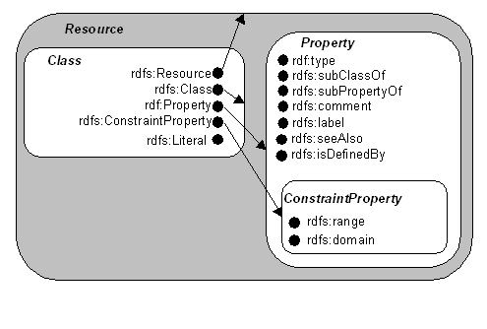
The built-in vocabulary for
RDF schema/ OWL
Specification about the RDFS and OWL is available on the Web ,that provides
the vocabulary for writing exact syntax
RDF Schema Specification 1.0 (http://www.w3.org/TR/2000/CR-rdf-schema-20000327/)

Slide 33
RDFS \ OWL Terminology and Semantics
Language vocabulary provides the elements for writing
Classes and a class hierarchy
  All classes are instances of rdfs:Class element
  A class hierarchy is defined by rdfs:subClassOf element
Instances of a class
  Defined by rdf:description element
Properties
  Properties are local in RDFS and global in OWL
  Properties form a hierarchy, too (rdfs:subPropertyOf) element

Slide 34
Example of RDFS syntax
<rdfs:Class rdf:about="http://www.co-ode.org/ontologies/pizza/pizza.owl#AmericanPizza">
<rdfs:label>Americana</rdfs:label>
<rdfs:subClassOf rdf:resource="http://www.co-ode.org/ontologies/pizza/pizza.owl#NamedPizza"/>
</rdfs:Class>
HERE
rdfs:about – name of the subject the subject resource
rdfs:label - a human-readable name for the subject

Slide 35
0WL
It builds upon the RDFS specification.
More expressive than RDFS
  Disjointness (owl:disjointWith)
  Equivalence (owl:equivalentClass)
  Also property are more expessive.
Example showing OWL syntax
<owl:Class rdf:about="http://www.co-ode.org/ontologies/pizza/pizza.owl#NonVegetarianPizza">
<owl:disjointWith rdf:resource="http://www.co-ode.org/ontologies/pizza/pizza.owl#VegetarianPizza"/>
</owl:Class>

Slide 36
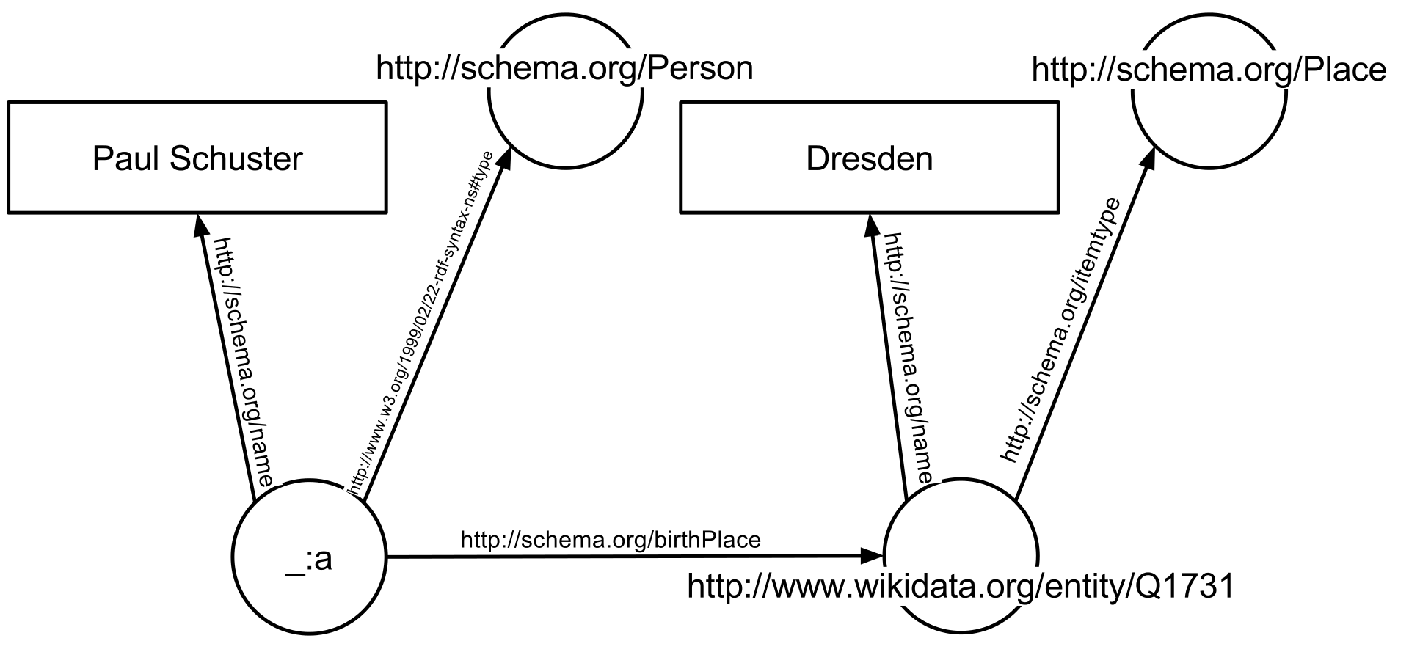


Slide 37
Property Elements in RDFS/OWL
Cardinality
- can have Any property single, multiple ,min ,max values
- We can define restriction on cardinality in OWL
Range and Domain of a property
  More than one domain and range may be declared.
  Special properties
owl:TransitiveProperty
- such as \has better grade than, \is taller than
owl:SymmetricProperty
- such as \has same grade as, \is sibling of

Slide 38
Example Property
<owl:ObjectProperty rdf:about="http://www.co-ode.org/ontologies/pizza/pizza.owl#hasIngredient">
<rdf:type rdf:resource="&owl;TransitiveProperty"/>
<rdfs:domain rdf:resource="http://www.co-ode.org/ontologies/pizza/pizza.owl#Food"/>
<rdfs:range rdf:resource="http://www.co-ode.org/ontologies/pizza/pizza.owl#Food"/>
</owl:ObjectProperty>

Slide 39
More Ways To Define a Classes
Union of classes(owl:unionof element)
  A class Person is a union of classes Male and Female
Intersection of classes(owl:intersectionof elements)
  A class SpicyPizza is an intersection of Pizza and Spicy Class
Same way we can define class by taking compliment of other classes(owl:complimentof element)
  Example
  <owl:Class rdf:ID="peopleAtUni">
<owl:unionOf rdf:parseType="Collection">
<owl:Class rdf:about="#staffMember"/>
<owl:Class rdf:about="#student"/>
</owl:unionOf>
</owl:Class>

Slide 40
Research Issues in Ontology Engineering
Content Acquisition
Analysis and evaluation
Maintenance
Ontology Merging
Notes:
There are various problem which comes in picture while designing an efficient Ontology. We need to collect Data and information for creation of Ontology. We need automated knowledge acquisition techniques like
Linguistic techniques where ontology acquisition is done from text,
Machine-learning which generate ontologies from structured documents (e.g., XML documents)
Exploiting the Web structure which generate ontologies by crawling structured Web sites
Knowledge-acquisition templates, the experts specify only part of the knowledge required
There is possibility of duplication. so duplicate Data also should be removed at the time of acquisition as much as possible.
After creation of Ontology, the effectiveness of Ontology should be analyzed and measured quantitatively. There is also need of regular update for Ontology to accommodate real world changes.
Ontology merging is also an issue because of ambiguity.

Slide 41
Evaluation
One of the hardest problems in ontology design
Ontology design is subjective
What does it mean for an ontology to be correct (objectively)?
The best test is the application for which the ontology was designed(for e.g pizza selling agent for e-commerce website)
Notes:
Measuring the effectiveness quantitatively is one of the hardest problems in ontology design. As we know, ontology is built on collection of data so it is subjective. However, we need to know how much better is our design compare to other ontology. The best way to evaluate ontology is to test with an application of that field.

Slide 42
Evalution Approach
Gold Standards: by comparing the ontology with a “gold standard”;
Application-based: by using the ontology with an application and evaluating the results;
Data-driven: by comparing the ontology with a source of data from the domain to be covered ;
Assessment by domain experts
Notes:
Now, Evaluation can be done by various approach, First one is Gold Standards. In this case, ontology is compared with standard resources like WordNet and accordingly measurement has been done.
Second is Application Based, Designed Ontology is checked with application. For e.g. when an customer ask for particular pizza then what are the other pizza comes related to it.
Data driven is similar to Gold standards but here the domain is fixed and limited.
There is also a method in which ontology is judged by expertise

Slide 43
Structural Evaluation Method
Class Match Measure
  Full Match & partial Match
Density Measure
  n.o. of subclass,attribute,siblings etc
Betweenness Measure
  Betweenness value
  More Central classes?
Semantic Similarity Measure
  calculates how close the classes that matches the search terms
  Min no. of links between two concepts
Notes:
There are some factors by which measurement is done. the factors are,
The Class Match Measure (CMM) is meant to evaluate the coverage of an ontology for the given search terms. An ontology that contains all search terms will obviously score higher than partial matches. For example if searching for “Student” and “University”, then an ontology with two classes labeled exactly as the search terms will score higher in this measure than another ontology which contains partially matching classes, e.g. “University Building” and “PhD-Student”.
Density Measure, When searching for a “good” representation of a specific concept, one would expect to find certain degree of detail related to that concept. This may include how well the concept is further specified (the number of subclasses), the number of attributes associated with that concept, number of siblings, etc. All this is taken into account in the Density Measure (DEM). DEM approximate the representational-density or information-content of classes and consequently the level of knowledge detail.
The Betweenness Measure (BEM) calculates the betweenness value of each queried concept in the given ontology. Ontology where the classes are more central will receive a higher score.
The Semantic Similarity Measure (SSM) calculates how close the classes that matches the search terms are in an ontology. SSM is measured from the minimum number of links that connects a pair of concepts. These links can be a relationships or object properties.
These are quantitative measure. After getting all these score, Total score is obtain as weighted sum of all measure and based on that score, Ontology is ranked or evaluated.

Slide 44
Ontology Maintenance
Ontology merging
  Having two or more overlapping ontology, create a new one
Ontology mapping
  Create a mapping between ontologies
Versioning and evolution
  Compatibility between different versions of the same ontology
  Compatibility between versions of an ontology and instance data
Notes:
Ontology merging defines the act of bringing together two conceptually divergent ontologies. This is similar to work in database merging (schema matching). This can be done either manually, semi-automated or automated. Manual ontology merging is extremely labor intensive and current research attempts to find semi or entirely automated techniques to merge ontologies. These techniques are statistically driven often taking into account similarity of concepts through semantic knowledge.
Mapping is to relate two different ontology via virtual link.
There is also need to update same ontology as per new information. so developed ontology should be compatible to accommodate such changes.

Slide 45
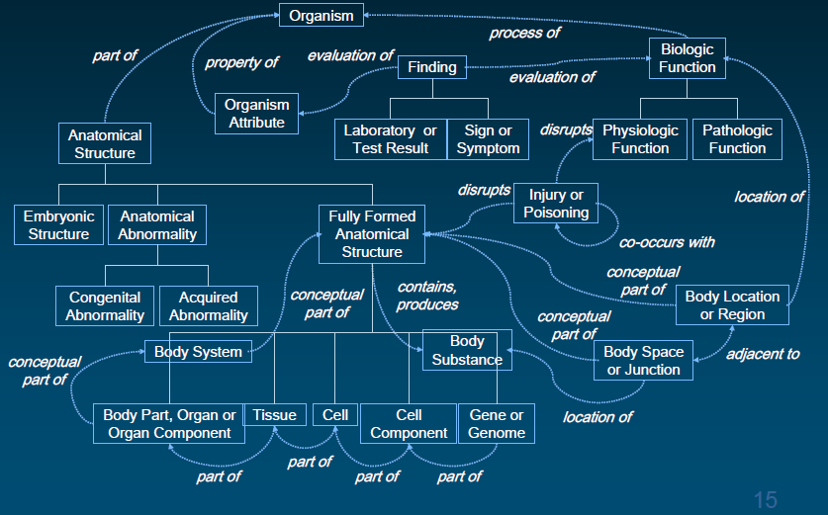
Case Study : UMLS Ontology

Slide 46
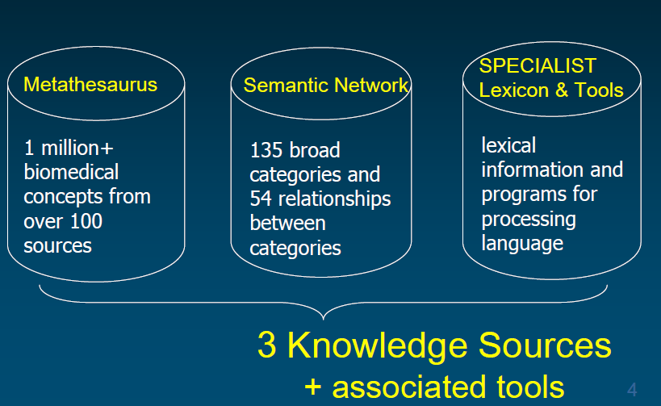
UMLS Consists of…

Slide 47
Conclusion
there is no single correct ontology for any domain.
Ontology design is a creative process and no two ontologies designed by different people would be the same.
The potential applications of the ontology and the designer’s understanding and view of the domain will undoubtedly affect ontology design choices.
we can assess the quality of our ontology only by using it in applications for which we designed it.

Slide 48
Bibliography
Baclawski, K., M. Kokar, P. Kogut, L. Hart, J. Smith, W. Holmes, J. Letkowski, and M. Aronson. 2001. “Extending UML to support ontology engineering for the semantic web.” «UML» 2001—The Unified Modeling Language. Modeling Languages, Concepts, and Tools: 342–360.
Booch, G., Rumbaugh, J. and Jacobson, I. (1997). The Unified Modeling Language user guide: Addison-Wesley.
Braun, S., A. Schmidt, A. Walter, G. Nagypal, and V. Zacharias. 2007. Ontology maturing: a collaborative web 2.0 approach to ontology engineering. In Proceedings of the Workshop on Social and Collaborative Construction of Structured Knowledge at the 16th International World Wide Web Conference (WWW 07), Banff, Canada.
Cimiano, P., J. Völker, and R. Studer. 2006. “Ontologies on Demand? A Description of the State-of-the-Art, Applications, Challenges and Trends for Ontology Learning from Text.”
Dellschaft, K., and S. Staab. 2008. Strategies for the evaluation of ontology learning. In Proceeding of the 2008 conference on Ontology Learning and Population: Bridging the Gap between Text and Knowledge, 253–272.
Guarino, N. 1997. “Understanding, building and using ontologies.” International Journal of Human Computer Studies 46: 293–310.
Guarino, N., and Istituto (Roma) Consiglio nazionale delle ricerc. 1998. Formal ontology in information systems. Citeseer.
Guarino, N., and P. Giaretta. 1995. “Ontologies and knowledge bases: Towards a terminological clarification.” Towards Very Large Knowledge Bases Knowledge Building and Knowledge Sharing 1 (9): 25–32.
Jarrar, M., J. Demey, and R. Meersman. 2003. “On using conceptual data modeling for ontology engineering.” Journal on Data Semantics: 185–207.

Slide 49
Cont’d
Maedche, A., and S. Staab. 2001. “Ontology learning for the semantic web.” Intelligent Systems, IEEE 16 (2): 72–79.
Natalya F. Noy, “Ontology Development 101: A Guide to Creating Your First Ontology.”
National Library of Medicine and N. L. of Medicine, “UMLS Reference Manual,U.S. National Library of Medicine, National Institutes of Health, 2009.
Protege (2000). The Protege Project. http://protege.stanford.edu
Spyns, P., R. Meersman, and M. Jarrar. 2002. “Data modelling versus ontology engineering.” ACM SIGMOD Record 31 (4): 12–17.
Uschold, M. and Gruninger, M. (1996). Ontologies: Principles, Methods and Applications. Knowledge Engineering Review 11(2).
Welty, C., and N. Guarino. 2001. “Supporting ontological analysis of taxonomic relationships.” Data & Knowledge Engineering 39 (1): 51–74.

Slide 50


